Slide 1



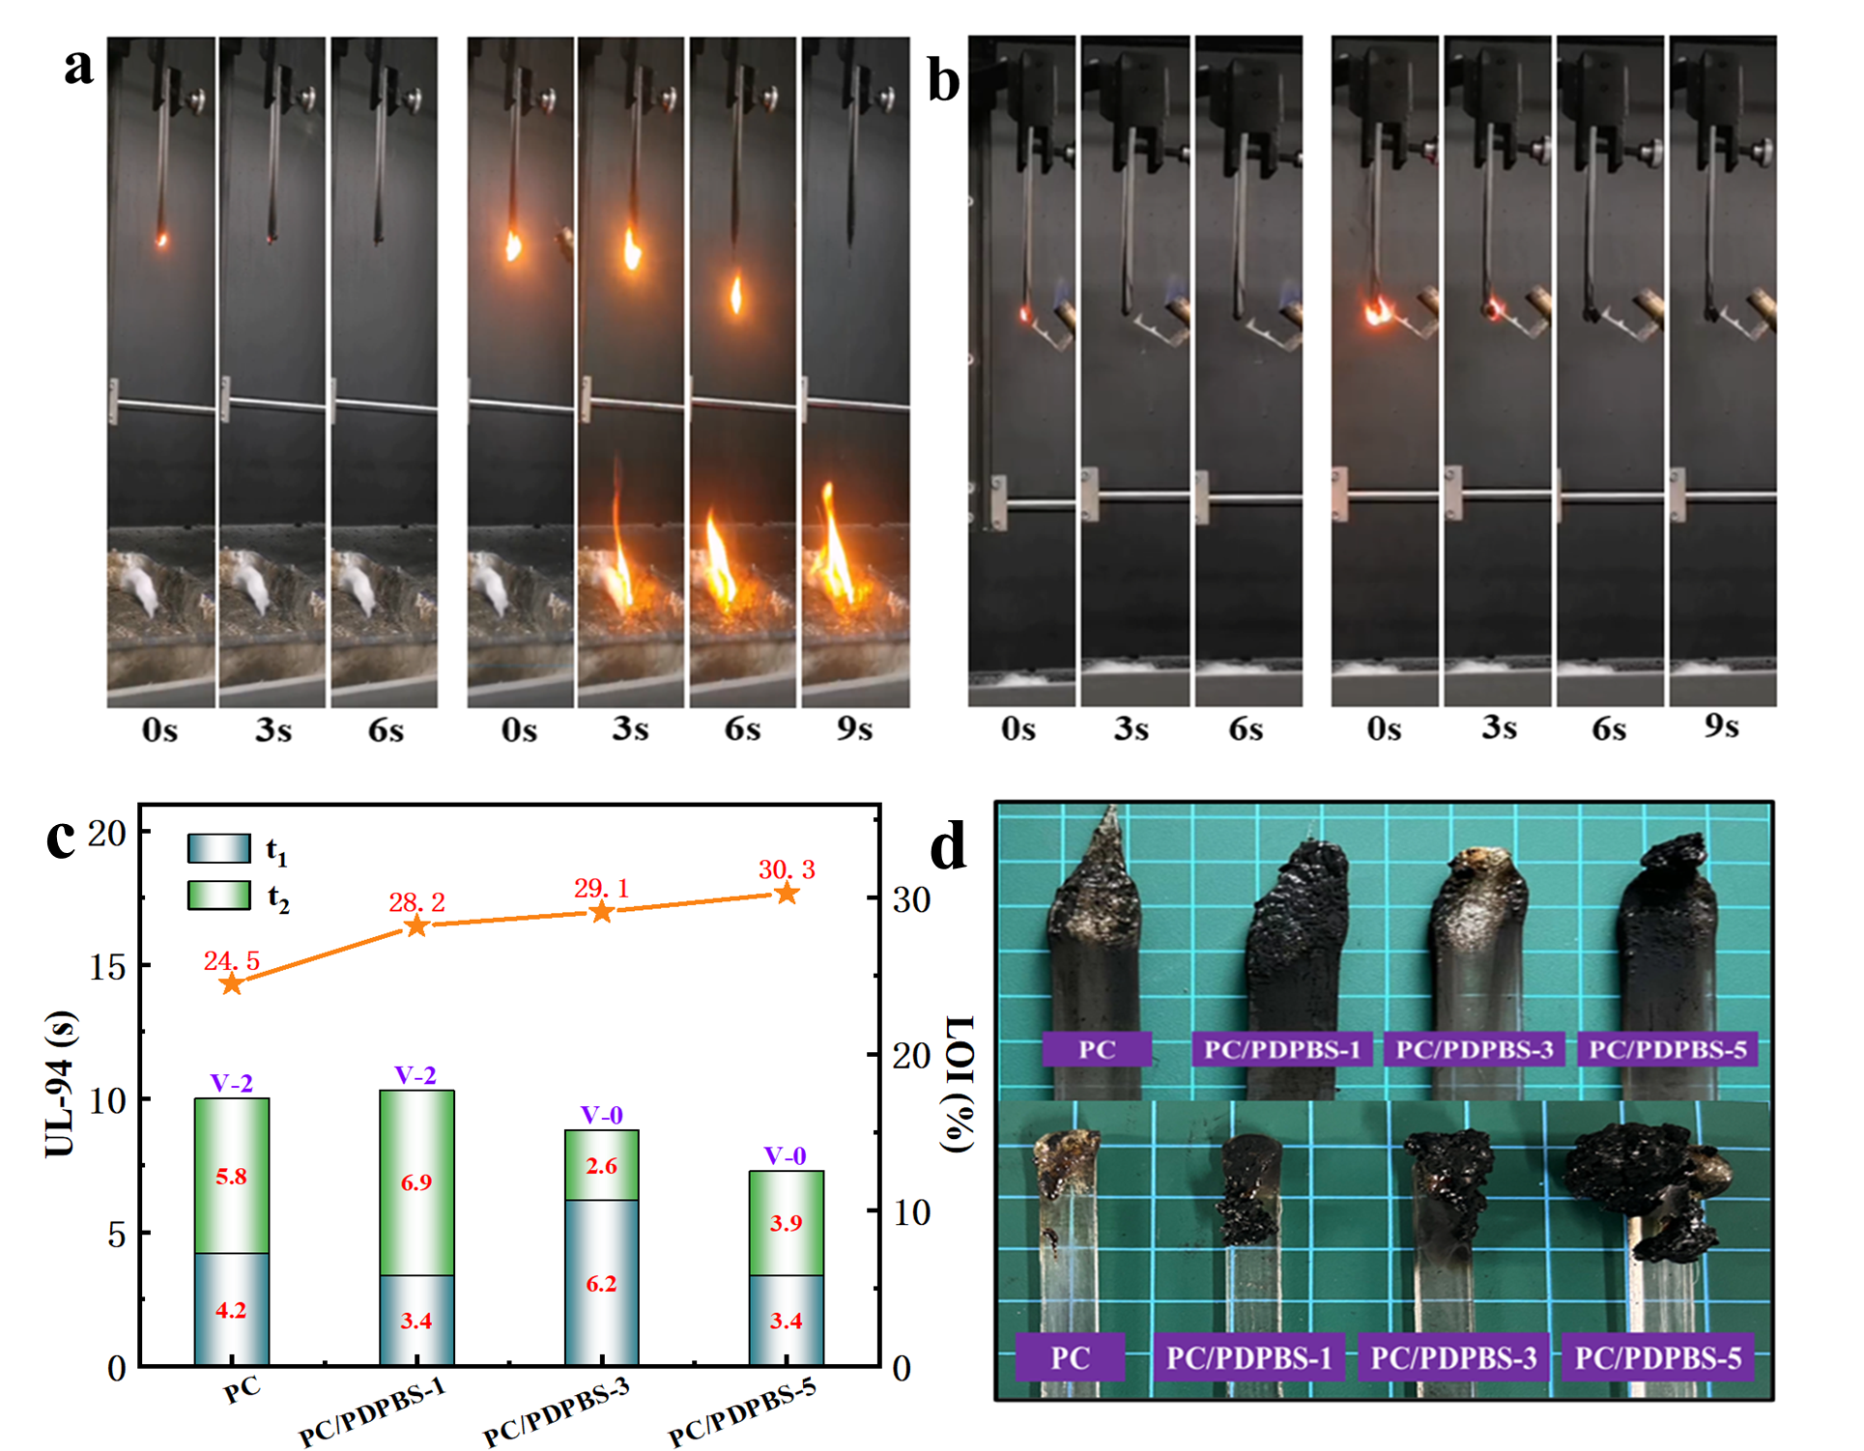

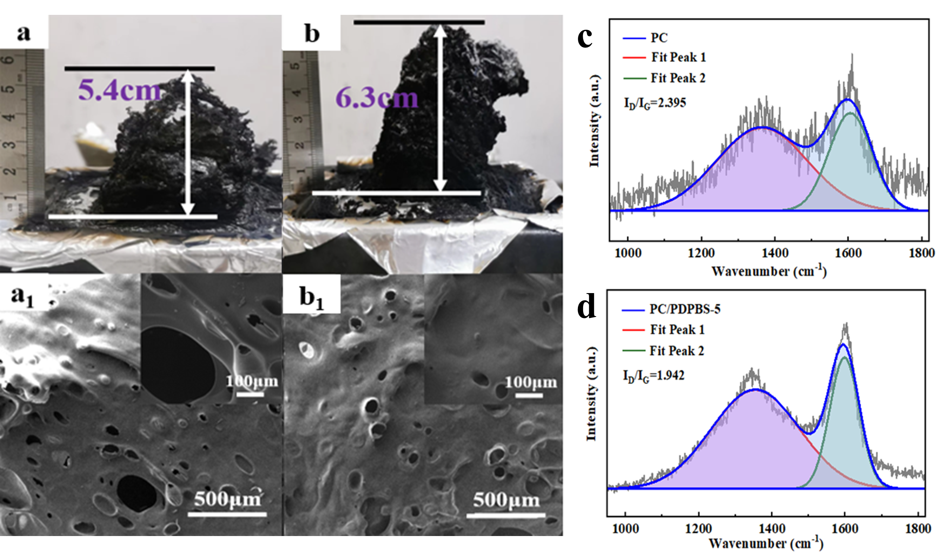
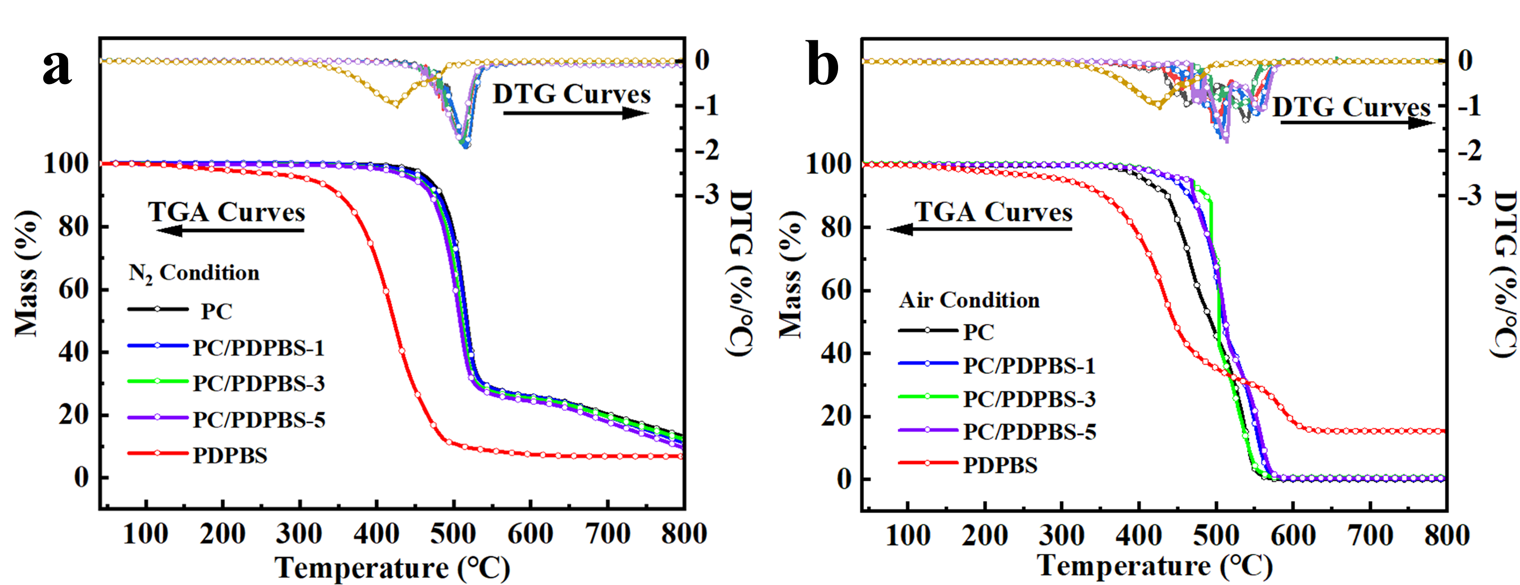
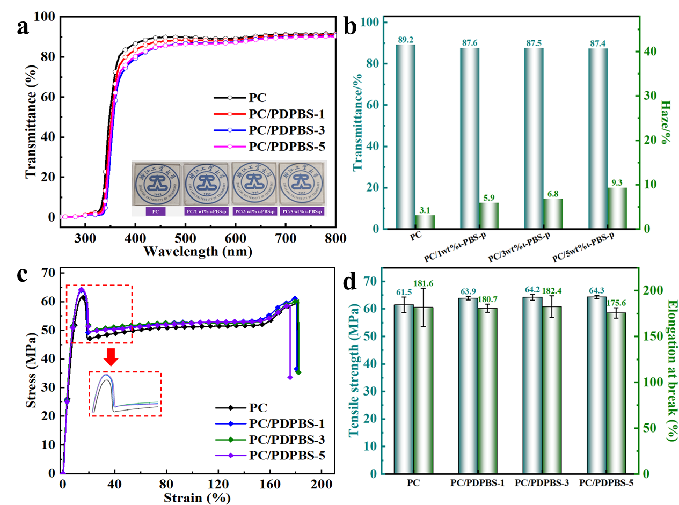
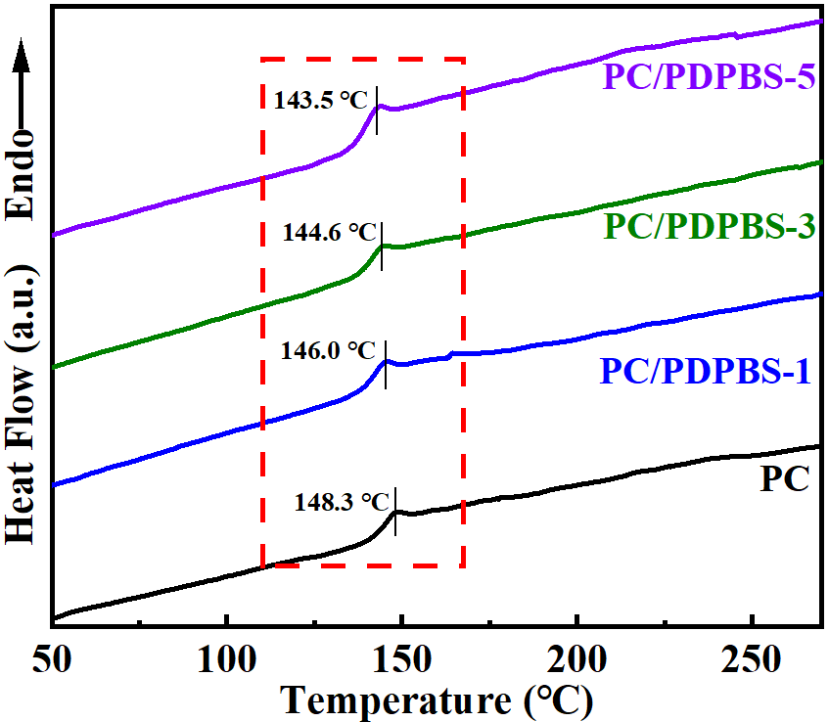

Achieving flame retardancy and high transparency of polycarbonate based on low addition of linear polyborosiloxane
Zongsheng Liu, Meng Ma*, Zhaoliang Jiang, Jian Xu, and Xu Wang*
College of Materials Sciecne and Engineering, Zhejiang University of Technology, Hangzhou, China
Corresponding author：mameng@zjut.edu.cn, wangxu@zjut.edu.cn
Abstract
As an engineering plastic with high transparency and excellent mechanical properties, polycarbonate (PC) is widely used in the production of many sensors, electronic and electrical equipment and 5G equipment. These applications require PC to have excellent flame retardancy, while maintaining excellent transparency and good mechanical strength. However, the existing flame retardants can not meet one of the requirements because of their inappropriate molecular design. In this work, a polyborosiloxane (PDPBS) flame retardant was synthesized, which endow PC with excellent flame retardancy and transparency while maintaining good mechanical properties. This work provides a new method for obtaining PC flame retardant composites with both flame retardant and transparent properties, and makes polycarbonate be applied in the above industries.
Results and discussion
Effect of addition amount of PDPBS on flame retardancy of PC composites
Table 1. Data of the cone calorimetric experiment for PC and PC/PDPBS composites
Samples | TTI (s) | PHRR (kW/m²) | THR (MJ/m²) | PSPR (m²/s) | TSP (m²) | Char yield (wt%)
PC | 59 | 525 | 78.5 | 0.24 | 22.75 | 12.4
PC/PDPBS-5 | 66 | 462 | 66.5 | 0.23 | 24.28 | 31.1
Figure 1. Screenshot of vertical combustion test: (a) PC, (b) PC/PDPBS-5; (c) Vertical combustion and LOI value and (d) Spline photos of PC composites.
Figure 2. Photos and micro-morphology of carbon residue after cone calorimetry test: (a, a₁) PC, (b, b₁) PC/PDPBS-5; (c) and (d) Raman spectrogram of carbon residue
  Thermal stability and thermal properties of PC composites
Transparency and mechanical property of PC Composites
The thermal stability of PDPBS can meet the processing temperature of PC.
The addition of flame retardant decreased the T_{g} of PC, which was attributed to plasticization.
Figure 3. (a) and (b) TG/DTG curves of PC composites and PDPBS under nitrogen and Air conditions; (c) DSC curves of PC composites.
Figure 4. (a) UV-Vis spectra, (b) transmittance and haze, (c) stress-strain curve and (d) tensile strength and elongation at break of PC composites
Conclusion
This work can improve the flame retardancy of PC composites while still maintaining good transparency. The tensile strength and elongation at break of PC composites are kept at the same level as those of pure PC. This work provides a new method to obtain PC flame-retardant composites with both flame-retardant and transparent properties, and makes the practical application of polycarbonate in the above industries.
Acknowledgements: this work was supported by the National Natural Science Foundation of China (grant no. 52273044) and the Key Research Program of Zhejiang Province (grant no. 2020C01010 ).

