Slide 1

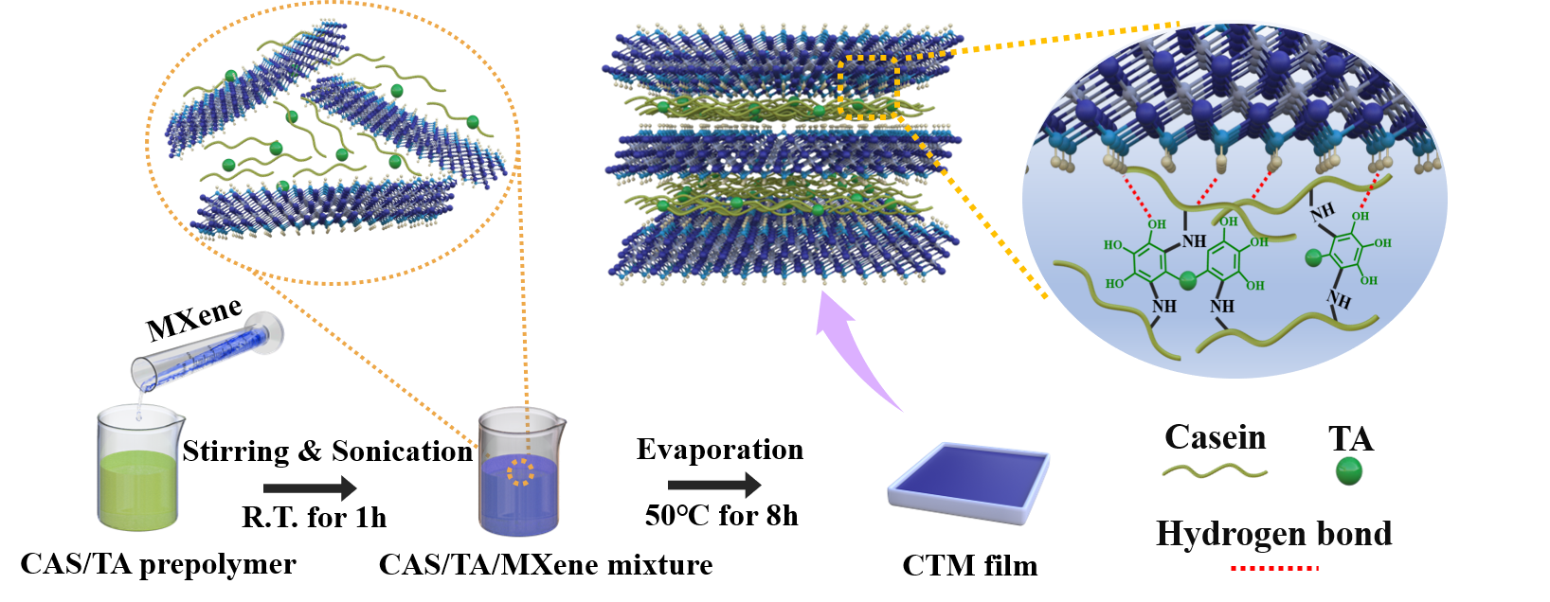
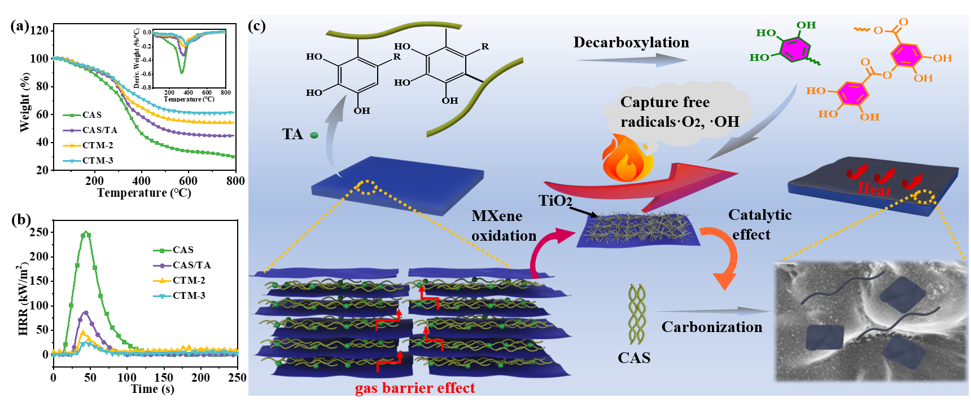
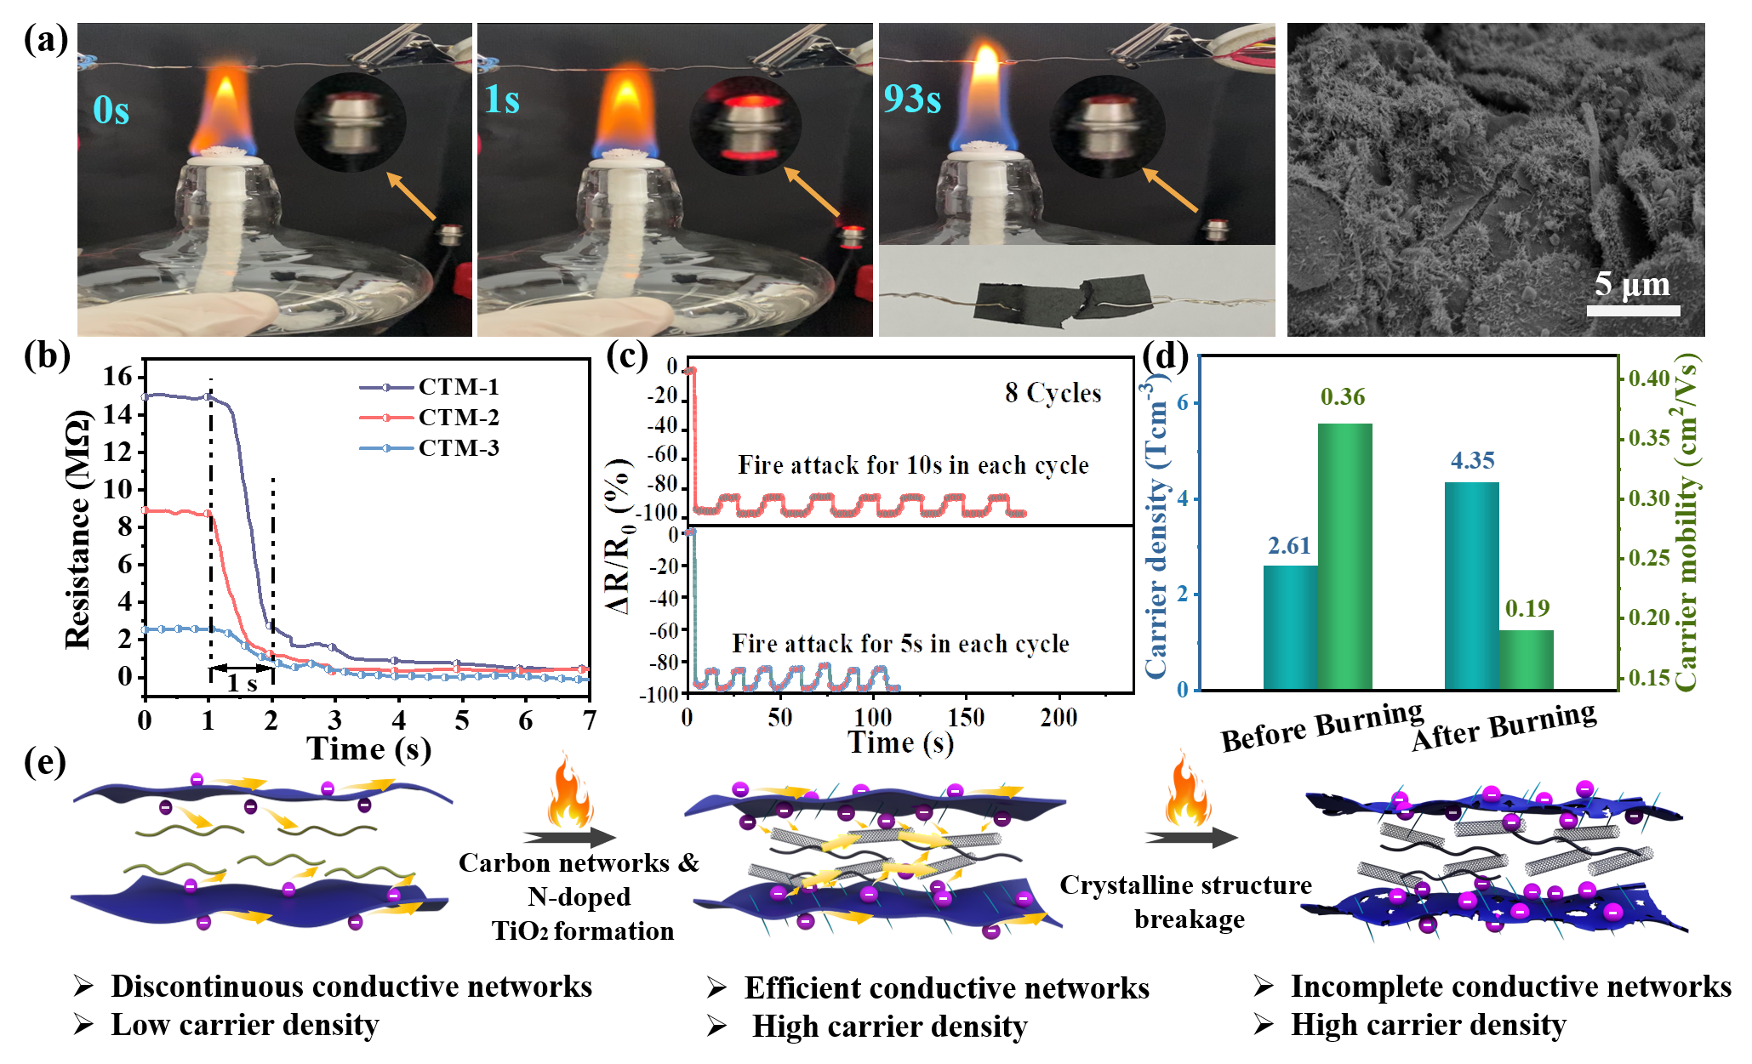
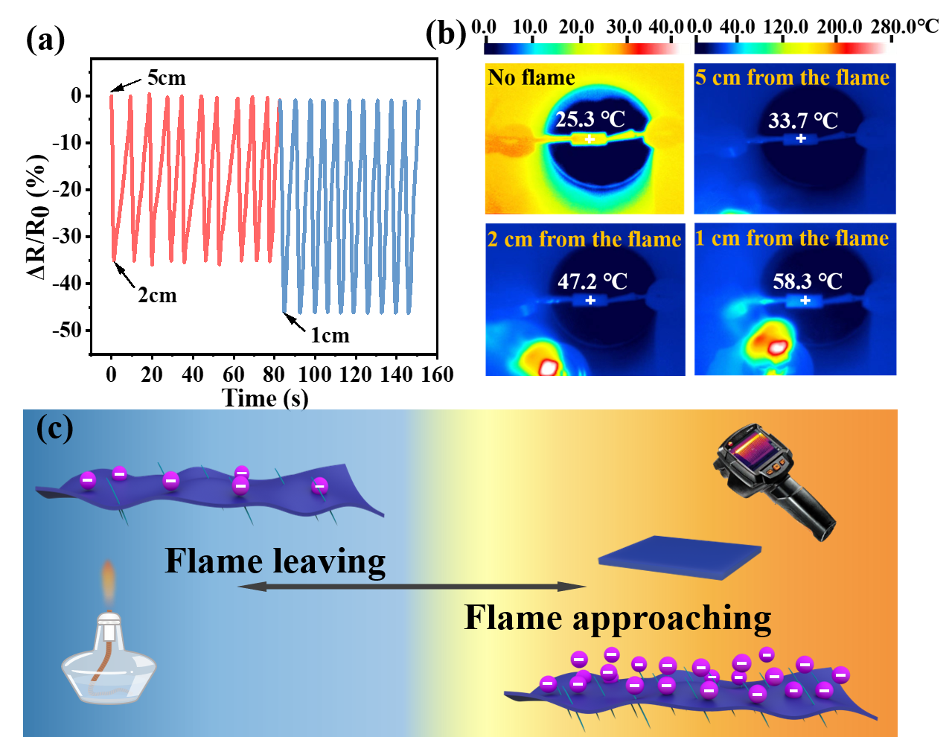
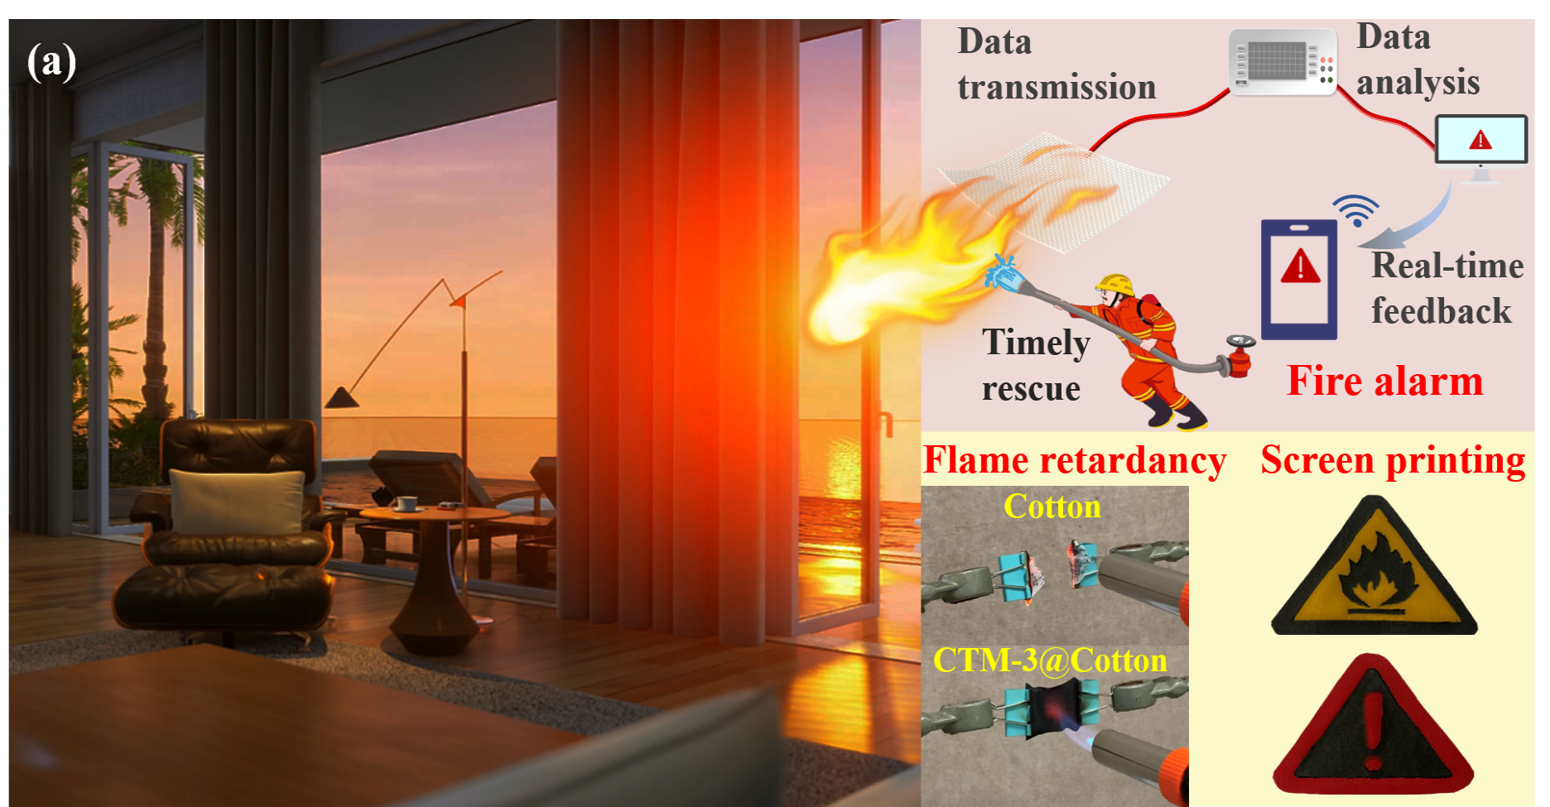
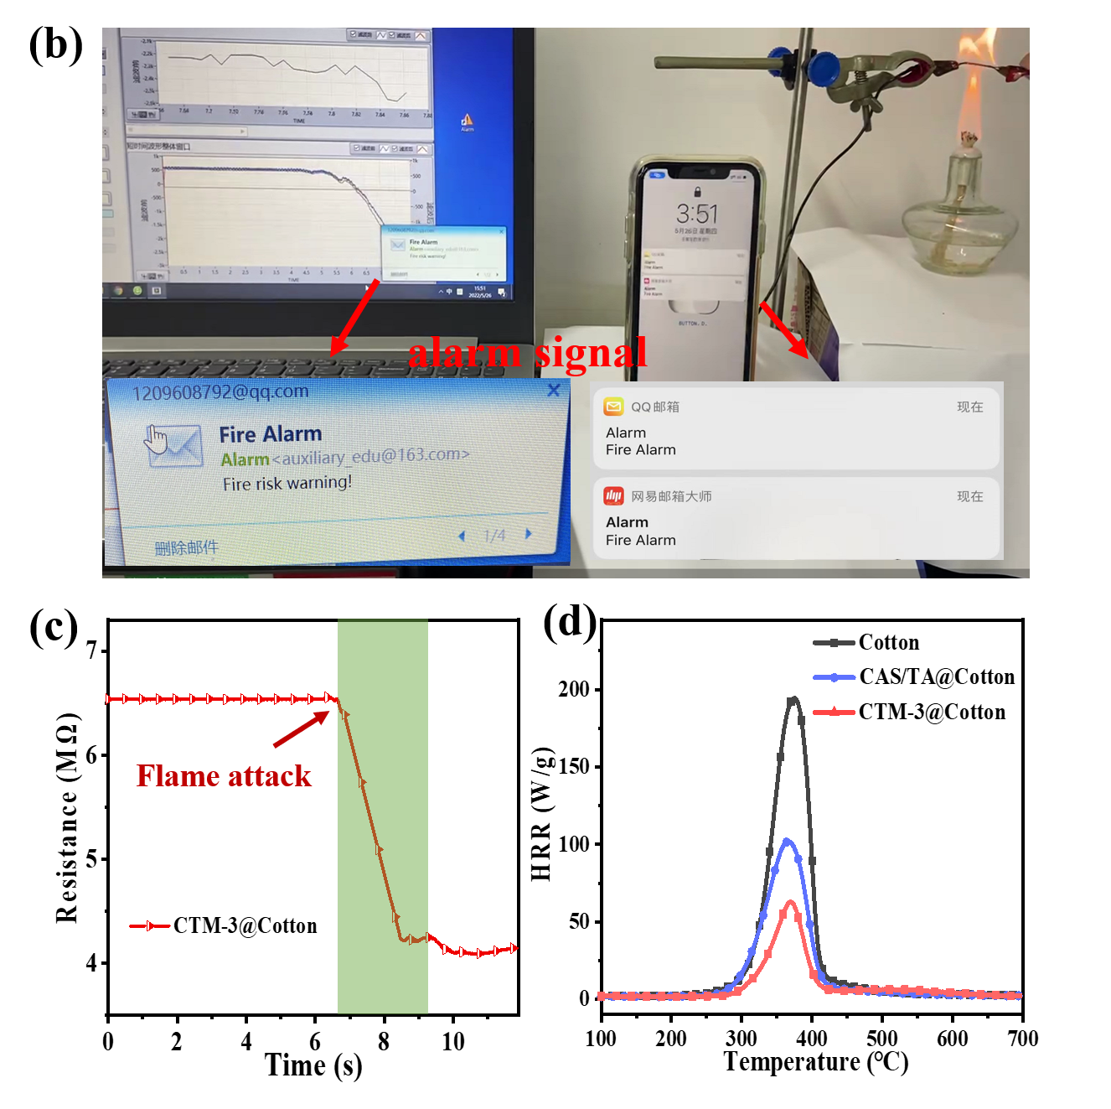
江南大学
Jiangnan University
Mechanically Flexible and Flame Retardant Polyphenol-bridged Casein/MXene Composite for Fire Proofing and Repeatable Contact/Non-contact Fire Monitoring
Yanyun Mao† , Dong Wang *, †
†Jiangsu Engineering Research Center For Digital Textile Inkjet Printing, Key Laboratory of Eco-Textile, Jiangnan University, Wuxi, Jiangsu 214122, China
*Correspondence to: Dong Wang (winter36@jiangnan.edu.cn)
Abstract
Herein, a biobased durable, reusable and highly sensitive fire warning composite (CTM) was developed using casein as the film-forming agent and dopant, MXene (Ti3C2Tx) as the conductive skeleton, and tannic acid as the crosslinking agent and free radical scavenger. Notably, the resultant CTM composite exhibits mechanically flexible properties, excellent thermal stability and superb fire safety performance. More importantly, the CTM presents reliable and rapid cycle warning responses under both direct flame attack and non-contact fire threat. Moreover, this CTM composite can easily be coated on flexible textiles to develop a large-scale wireless real-time fire alarming system that can deliver the monitored signal to remote sites within only 3 s, thus it provides a potential application prospect in constructing smart fire-safe buildings.
Results & Discussion
Fig. 1 Schematic of fabricating process for CTM film.
Fig. 2 Flame-retardant performance and mechanism analysis.
Non-contact/Contact Fire Alarming
PAN
MPZSN-MoS₂/PAN
PAN
MPZSN-MoS₂/PAN
PAN
Fig. 3 The non-contact fire monitoring performance.
Fig. 4 The flame-triggered alarming performance.
Portable remote fire sensing
Fig. 5 Demonstration of flame-retardant alarm remote sensing.
Conclusion
The CTMcomposite exhibits satisfactory qualities of flame retardancy and thermal stability.
The CTM sensor exhibits sensitive repeatable flame-triggered conversion from an insulator to a semiconductor and non-contact flame position detection.
The CTM composites can be easily integrated into textiles for achieving a wireless fire alarming performance.

